Slide 1



Manufacturing Defect Detection Using Texture Features and ML Classifiers
Aleena Antony
Ardra VS
Nakshathra V

Slide 2

Problem Statement
Manual inspection is time-consuming and error-prone
Inconsistent detection of surface defects
Lack of automated, reliable defect detection systems
Need for a scalable and efficient solution
Focuses on automating defect detection in industrial products

Slide 3
Objective
Build a system to classify images as defective or non-defective
Use texture-based feature extraction techniques
Apply machine learning models (no deep learning)
Evaluate performance using standard metrics

Slide 4

Dataset
Used NEU Surface Defect Dataset
Contains:
Normal (non-defective) images
Multiple defect types (scratches, cracks, etc.)
Industrial-quality images for real-world relevance

Slide 5
Methodology Overview
Data Collection
Image Preprocessing
Feature Extraction (LBP, GLCM, Gabor)
Feature Concatenation
Feature Selection
Model Training
Evaluation

Slide 6
Feature Extraction – LBP
Local Binary Pattern (LBP)
Captures local texture patterns
Converts pixel neighborhoods into binary values
Advantages:
Simple and fast
Robust to illumination changes

Slide 7
Feature Extraction – GLCM
Gray Level Co-occurrence Matrix (GLCM)
Extracts statistical texture features:
Energy (uniformity)
Contrast (intensity variation)
Entropy (randomness)
Homogeneity (smoothness)

Slide 8
Feature Extraction – Gabor Filters
Captures frequency and orientation information
Applied at:
Multiple scales
Multiple orientations
Effective for detecting directional textures

Slide 9
Feature Engineering
Combine:
LBP features
GLCM features
Gabor features
Create a single feature vector
Apply feature selection to:
Reduce dimensionality
Improve model performance

Slide 10
Machine Learning Models
Support Vector Machine (SVM)- Its a powerful classifier that works by finding the optimal hyperplane that maximizes the margin between different classes in a high-dimensional feature space.
Random Forest - is an ensemble learning method that constructs a multitude of decision trees during training and outputs the class that is the mode of the classes of the individual trees.
Gradient Boosting- is another ensemble technique, but unlike Random Forest, it builds trees sequentially, where each new tree attempts to correct the errors made by the previous ones.

Slide 11
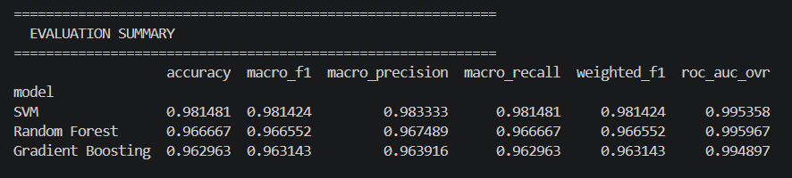
Evaluation Metrics
Accuracy – Percentage of correctly classified samples.
Precision – Correct defect predictions
Recall – Ability to detect defects
ROC-AUC Curve – Model performance across thresholds
Precision-Recall Curve – Important for imbalance

Slide 12
Results
SVM Accuracy: 98%
Random Forest Accuracy: 96.6%
Gradient Boosting Accuracy: 96.2%
Best Model: SVM

Slide 13
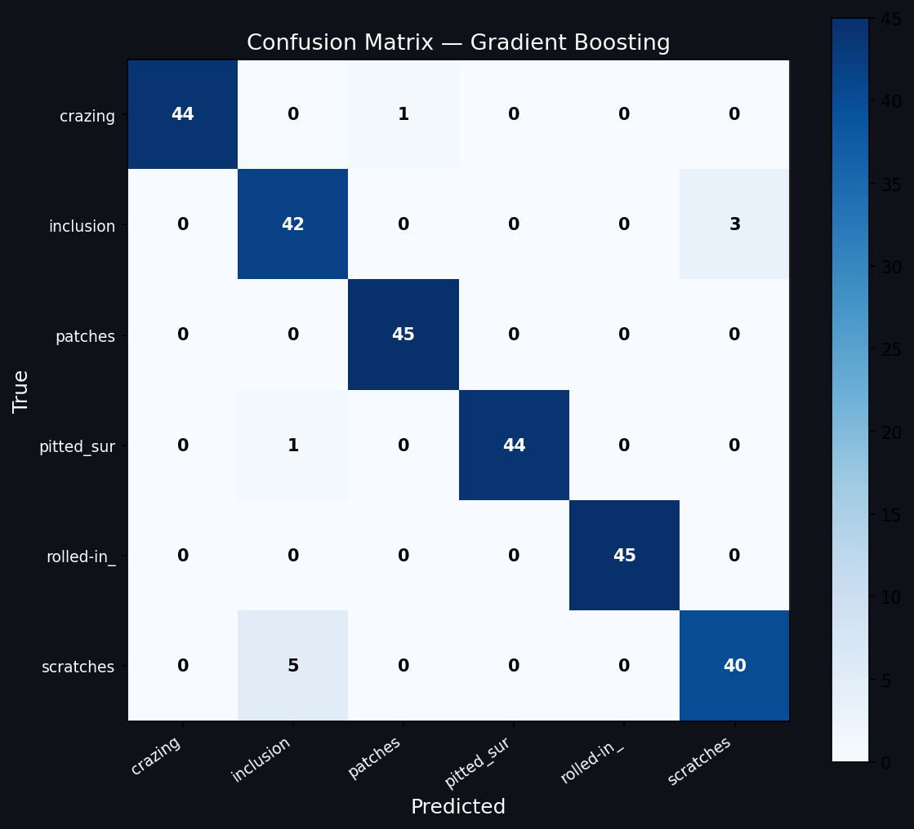

Slide 14


Slide 15
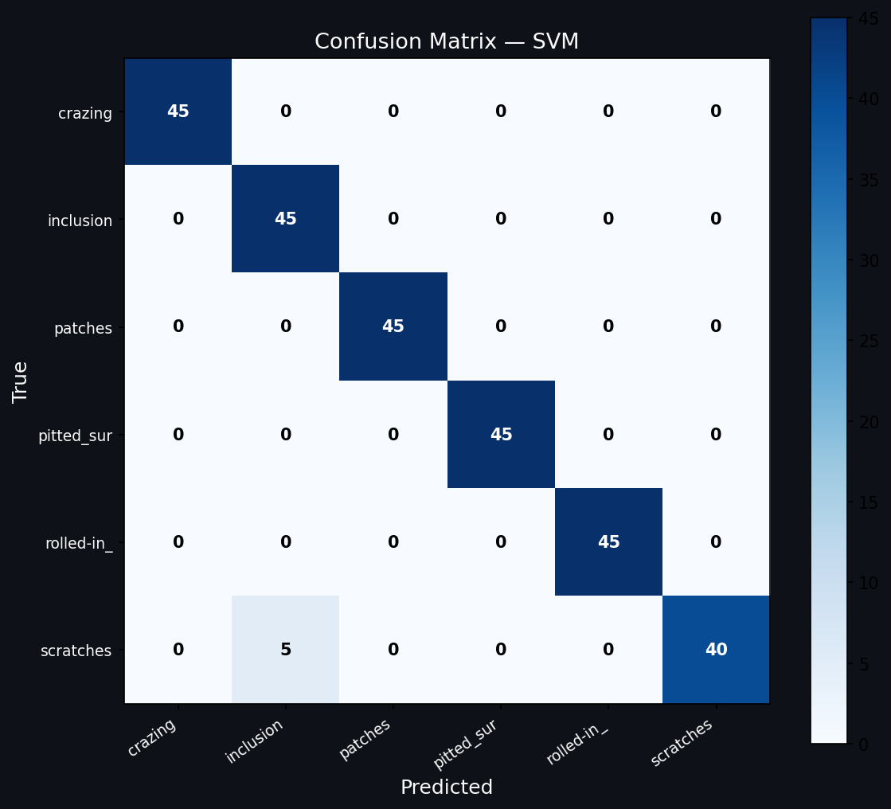

Slide 16
Conclusion
Traditional ML can effectively detect defects
No need for deep learning in some cases
Texture features are powerful for surface inspection
System is:
Fast
Cost-effective
Interpretable

Slide 17
Thank You

